Slide 1
Artificial Neural Networks & Backpropogation
Slides adapted from Torsten Reil, Andrew Rosenberg, Fei-Fei Li, Andrej Karpathy, Justin Johnson and Etham Alpaydin

Slide 2
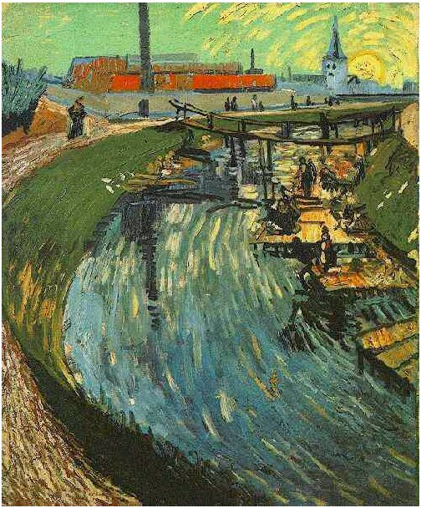
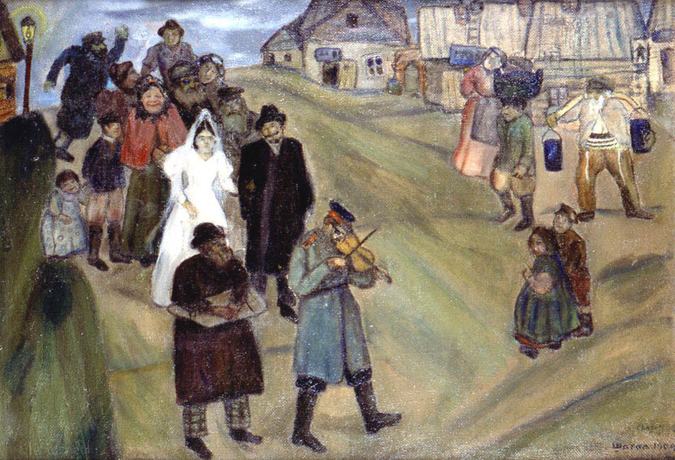
Can you name the artist?
Notes:
Canal with Women Washing, 1888

Slide 3
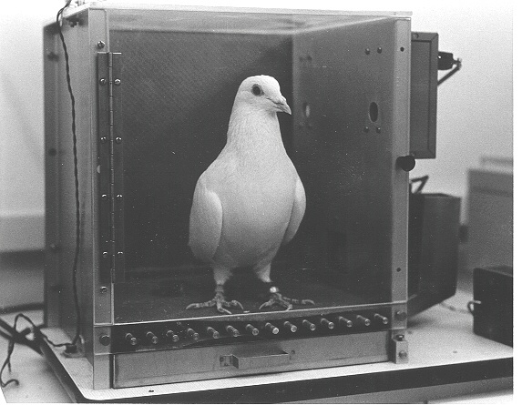
Biological Neural Nets
Pigeons as art experts (Watanabe et al. 1995)
Experiment:
Pigeon in Skinner box
Present paintings of two different artists (e.g. Chagall / Van Gogh)
Reward for pecking when presented a particular artist

Slide 4
Pigeon-Art Experiment Results
Pigeon in-sample error of 5%
presented with pictures they had been trained on
Out of sample error of 15%
New, unseen paintings of Chagall / Van Gogh
Pigeons must be learning something (not memorization)
Extract and recognise patterns (the ‘style’)
Generalize from the already seen to make predictions
This is the idea behind neural networks (biological and artificial)

Slide 5
Artificial Neural Networks (ANN)
Popular set of learning techniques
Popularity ebbs and flows over time
Currently in a resurgence
Common features of ANNs
Networks of simple elements
Inspired (loosely) by brain organization
Compact representation

Slide 6
ANNs (cont’d)
Highly parallel
Process information much more like the brain than a serial computer
Simple principles → complex behaviours
Applications
As powerful problem solvers
As biological models

Slide 7
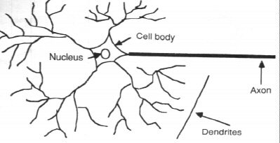
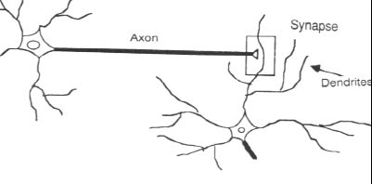
Biological Neuron
Signals arrive on synapses and enters cell through dendrites
(Relatively slow) electro-chemical process
Raises electrical potential of cell body
If potential is high enough, the cell fires pulse along axon
Process continues at synapse of another neuron

Slide 8
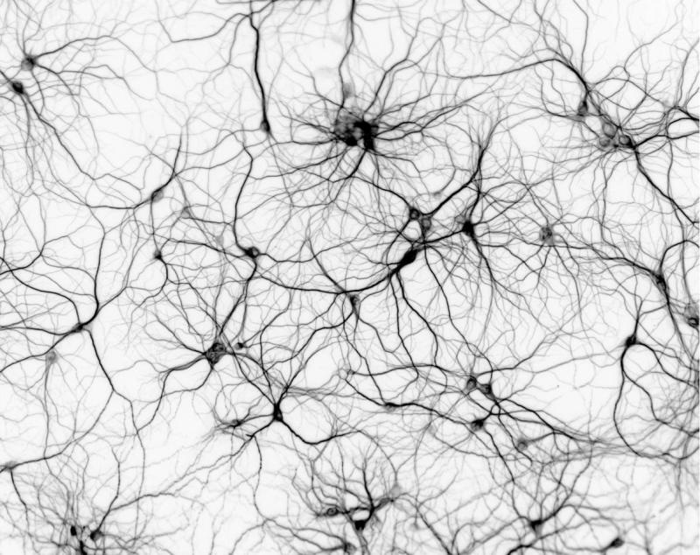
Biological Neural Network
Single neuron
Relatively simple
Neural network
Many neurons
Complex connectivity
Basis for everything we do, remember, etc.

Slide 9
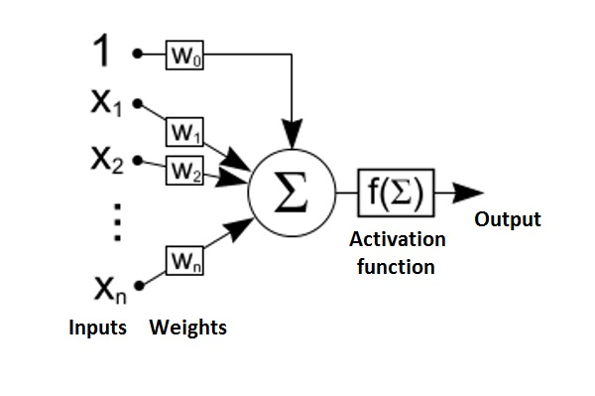
Artificial Neuron
McCulloch-Pitts (1943) proposed a computational model
Later extended to perceptron
Output depends on:
Inputs {0,1}
Weights
Threshold (activation)
Binary output
If (weighted sum of inputs) is greater than threshold

Slide 10
Real vs Artificial Neurons
Main differences
Discrete Time
No refractory period
Real neurons use spike trains, not single signals
Real neurons are often not threshold devices
Many real cells do nonlinear summation on inputs
Some research into more accurate neuron models
However, this is mostly to more accurately model neurons and not for ANNs

Slide 11
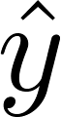
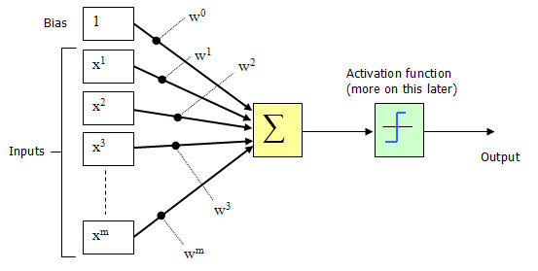
Perceptron (Visually)
m-dimensional input
1 output,
m+1 weights to learn
bias term + weights for each of m dimensions

Slide 12
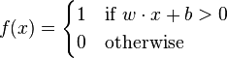
Threshold Units
Simple perceptrons
Very simple artificial neurons
Note output is 0/1 instead of -1/+1
Corresponds to the notion of neuron “firing”

Slide 13
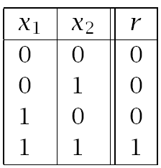
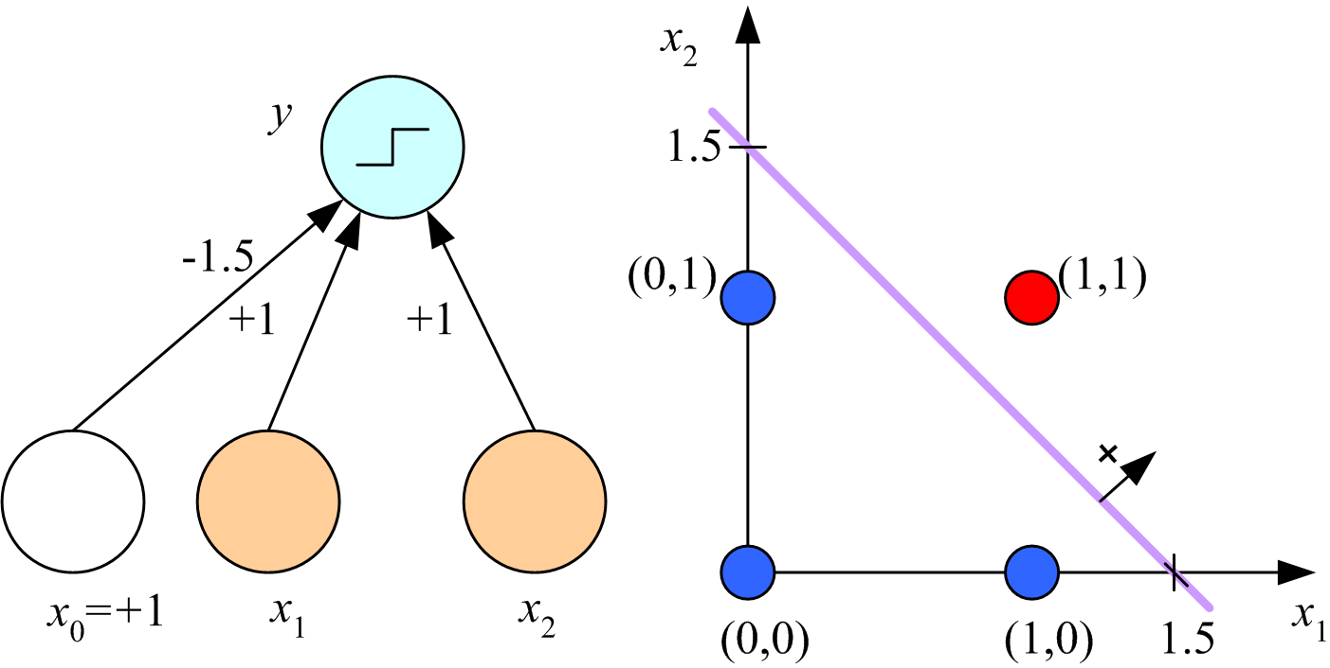
Boolean AND (w/ Threshold unit)

Slide 14
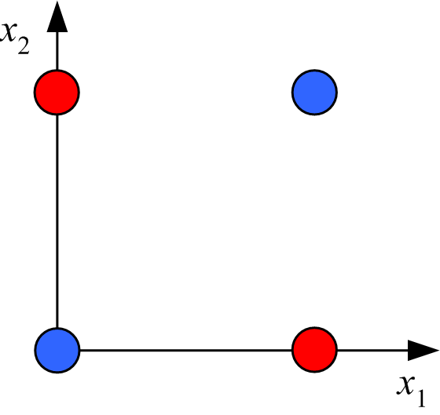
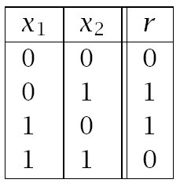
How about Boolean XOR?
Need w₀, w₁, w₂ to satisfy:
No set of weights will satisfy these equations.

Slide 15
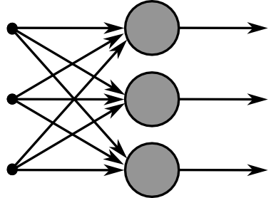

Multi-Layer Networks
Single perceptrons cannot compute certain simple functions, like XOR
We can overcome this using multiple layers
Number of layers may or may not count input layer (usually doesn’t)
One-Layer Perceptron
Two-Layer Perceptron

Slide 16
Multilayer Networks
Cascade Neurons together
The output from one layer is the input to the next
Each Layer has its own sets of weights

Slide 17
Feed-Forward Networks
Predictions are fed forward through the network to classify

Slide 18
Feed-Forward Networks
Predictions are fed forward through the network to classify

Slide 19
Feed-Forward Networks
Predictions are fed forward through the network to classify

Slide 20
Feed-Forward Networks
Predictions are fed forward through the network to classify

Slide 21
Feed-Forward Networks
Predictions are fed forward through the network to classify

Slide 22
Feed-Forward Networks
Predictions are fed forward through the network to classify

Slide 23
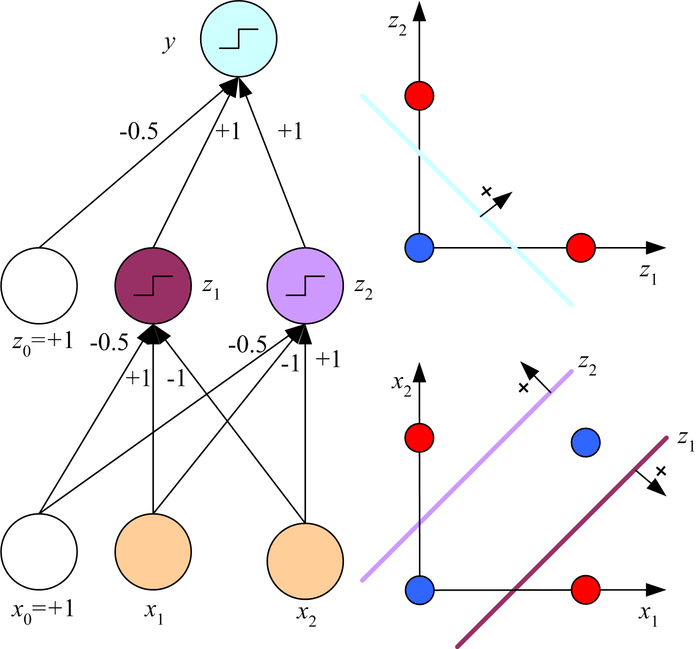
x₁ XOR x₂ = (x₁ AND ~x₂) OR (~x₁ AND x₂)

Slide 24
Multilayer Networks in Feature Space
More layers can handle more complicated spaces
but require more parameters
Each node splits the feature space with a hyperplane
Complexity of network → complexity of decision boundary

Slide 25
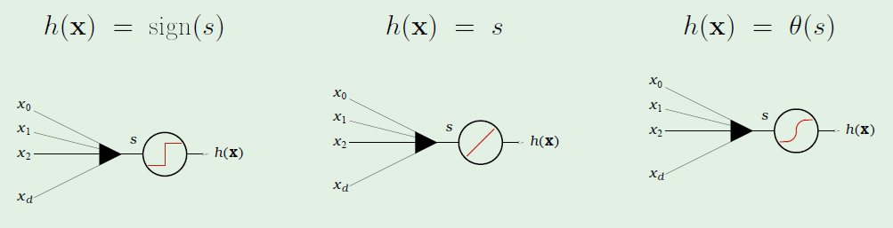
Many Types of Units
Perceptrons can do more than thresholding
Linear Regression
Logistic Regression
Many other nonlinear, differentiable functions
We’ll come back to this

Slide 26
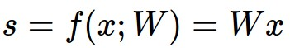
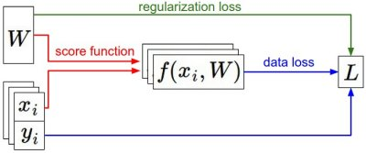
Generic Perceptron Training
We have some dataset: (X, Y)
We have a score function:
We have a loss function
with (possibly) regularization
Gradient Descent
e.g.
Hinge:
Exponential:
Squared loss:

Slide 27
Gradient Descent
pick a starting point (w)
repeat until loss doesn’t decrease in any dimension:
pick a dimension
move a small amount in that dimension towards decreasing loss (using the derivative)
Computing this derivative?

Slide 28
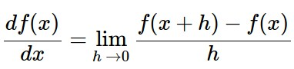
Numerical Gradient
In 1-dimension, the derivative of a function:
In multiple dimensions, the gradient is the vector of partial derivatives

Slide 29
current W:
[0.34,
-1.11,
0.78,
0.12,
0.55,
2.81,
-3.1,
-1.5,
0.33,…]
loss 1.25347
gradient dW:
[?,
?,
?,
?,
?,
?,
?,
?,
?,…]

Slide 30
current W:
[0.34,
-1.11,
0.78,
0.12,
0.55,
2.81,
-3.1,
-1.5,
0.33,…]
loss 1.25347
W + h (first dim):
[0.34 + 0.0001,
-1.11,
0.78,
0.12,
0.55,
2.81,
-3.1,
-1.5,
0.33,…]
loss 1.25322
gradient dW:
[?,
?,
?,
?,
?,
?,
?,
?,
?,…]

Slide 31
current W:
[0.34,
-1.11,
0.78,
0.12,
0.55,
2.81,
-3.1,
-1.5,
0.33,…]
loss 1.25347
W + h (first dim):
[0.34 + 0.0001,
-1.11,
0.78,
0.12,
0.55,
2.81,
-3.1,
-1.5,
0.33,…]
loss 1.25322
gradient dW:
[-2.5,
?,
?,
?,
?,
?,
?,
?,
?,…]
(1.25322 - 1.25347)/0.0001
= -2.5

Slide 32
current W:
[0.34,
-1.11,
0.78,
0.12,
0.55,
2.81,
-3.1,
-1.5,
0.33,…]
loss 1.25347
W + h (second dim):
[0.34,
-1.11 + 0.0001,
0.78,
0.12,
0.55,
2.81,
-3.1,
-1.5,
0.33,…]
loss 1.25353
gradient dW:
[-2.5,
?,
?,
?,
?,
?,
?,
?,
?,…]

Slide 33
current W:
[0.34,
-1.11,
0.78,
0.12,
0.55,
2.81,
-3.1,
-1.5,
0.33,…]
loss 1.25347
W + h (second dim):
[0.34,
-1.11 + 0.0001,
0.78,
0.12,
0.55,
2.81,
-3.1,
-1.5,
0.33,…]
loss 1.25353
gradient dW:
[-2.5,
0.6,
?,
?,
?,
?,
?,
?,
?,…]
(1.25353 - 1.25347)/0.0001
= 0.6

Slide 34
current W:
[0.34,
-1.11,
0.78,
0.12,
0.55,
2.81,
-3.1,
-1.5,
0.33,…]
loss 1.25347
W + h (third dim):
[0.34,
-1.11,
0.78 + 0.0001,
0.12,
0.55,
2.81,
-3.1,
-1.5,
0.33,…]
loss 1.25347
gradient dW:
[-2.5,
0.6,
?,
?,
?,
?,
?,
?,
?,…]

Slide 35
current W:
[0.34,
-1.11,
0.78,
0.12,
0.55,
2.81,
-3.1,
-1.5,
0.33,…]
loss 1.25347
W + h (third dim):
[0.34,
-1.11,
0.78 + 0.0001,
0.12,
0.55,
2.81,
-3.1,
-1.5,
0.33,…]
loss 1.25347
gradient dW:
[-2.5,
0.6,
0,
?,
?,
?,
?,
?,
?,…]
(1.25347 - 1.25347)/0.0001
= 0

Slide 36
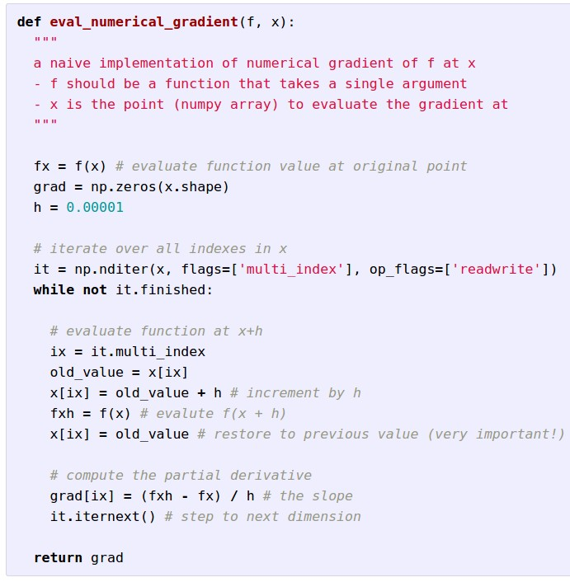
Evaluating the Gradient Numerically
approximate
slow to evaluate
All losses (L) are simply functions of the weights (W)
We can compute derivative analytically

Slide 37
current W:
[0.34,
-1.11,
0.78,
0.12,
0.55,
2.81,
-3.1,
-1.5,
0.33,…]
loss 1.25347
gradient dW:
[-2.5,
0.6,
0,
0.2,
0.7,
-0.5,
1.1,
1.3,
-2.1,…]
dW = ...
(some function of data and W)

Slide 38
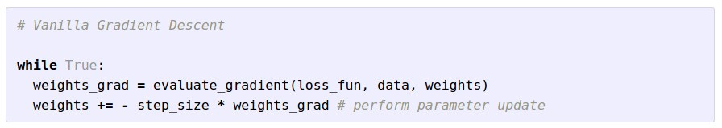
Summary
Numerical gradient: approximate, slow, easy
Analytic gradient: exact, fast, error-prone
In practice: Use analytic gradient, but check correctness with numerical gradient.
This is called a gradient check

Slide 39
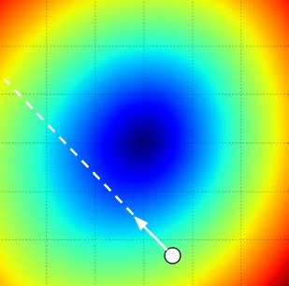
W_2
original W
W_1
negative gradient direction

Slide 40
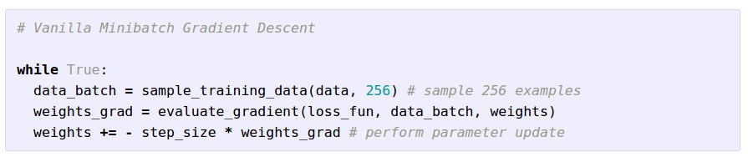
Mini-batch Gradient Descent
Only use a small portion of the training set to compute the gradient
Common mini-batch sizes are powers of 2 (e.g., 32, 64, 256)
Most common approach to training NN

Slide 41
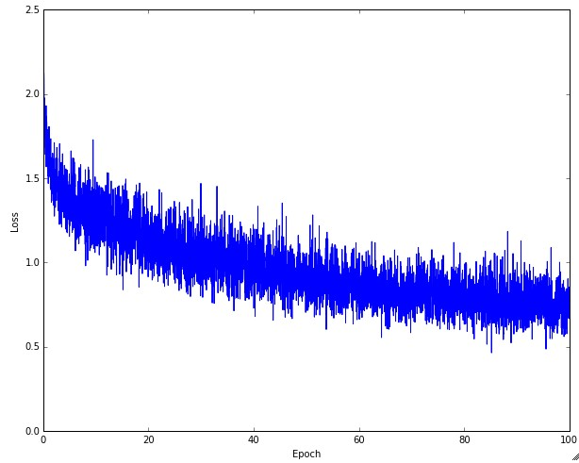
Example of optimization progress while training a neural network.
(Loss over mini-batches goes down over time.)

Slide 42

The effects of step size (or “learning rate”)

Slide 43
Weight Update Step
Can do something fancier than this vanilla update
Many algorithms (momentum, Adagrad, RMSProp, Adam, …)

Slide 44

The effects of different update formulas
(image credits to Alec Radford)

Slide 45
What do we have so far…
Components – biological plausibility
Neuron / node
Synapses / weight
Perceptrons / Artificial Neurons
Threshold Units (boolean functions / classification)
Linear Units (regression)
Nonlinear Units
Similarities across units…
All can be trained via gradient descent
Weights of the connections between nodes determine the behavior of a unit or network

Slide 46
How Do We Train MLPs?
Need to learn weights for all of the edges
PLA/GD works for 1-layer network
We will (slightly) modify this for MLP

Slide 47
Error Backpropagation
Gradient descent on the whole network
Training will proceed backwards
From the last layer to the first

Slide 48
Error Backpropagation
Error backprop unravels the multivariate chain rule and solves the gradient for each partial component separately
The target values for each layer come from the next layer
This feeds the errors back along the network

Slide 49
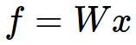

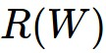
NN as a Computational Graph
Consider a neural network as a large computational graph
x
*
s (scores)
hinge loss
+
L
W
R

Slide 50
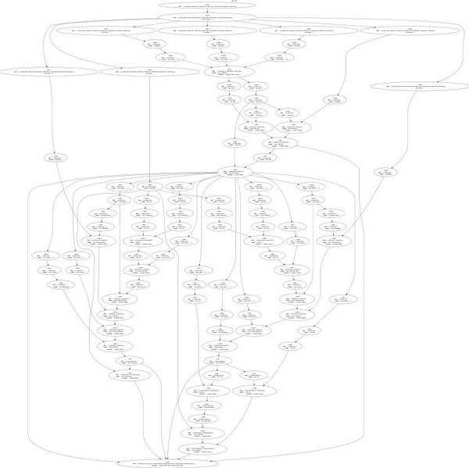

Larger Computational Graphs
input
weights
loss
AlexNet
Neural Turing Machine

Slide 51
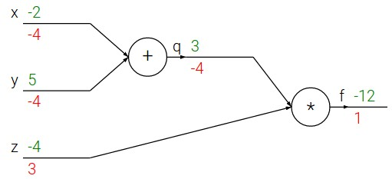
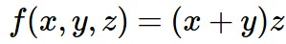
e.g. x = -2, y = 5, z = -4

Slide 52
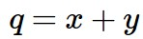
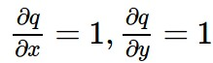
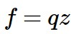
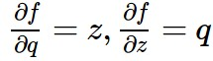
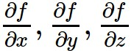
e.g. x = -2, y = 5, z = -4
Want:

Slide 53
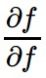
e.g. x = -2, y = 5, z = -4
Want:

Slide 54
e.g. x = -2, y = 5, z = -4
Want:

Slide 55
e.g. x = -2, y = 5, z = -4
Want:

Slide 56
e.g. x = -2, y = 5, z = -4
Want:

Slide 57
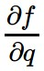
e.g. x = -2, y = 5, z = -4
Want:

Slide 58
e.g. x = -2, y = 5, z = -4
Want:

Slide 59
e.g. x = -2, y = 5, z = -4
Want:

Slide 60
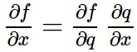
e.g. x = -2, y = 5, z = -4
Chain rule:
Want:

Slide 61
e.g. x = -2, y = 5, z = -4
Want:

Slide 62
e.g. x = -2, y = 5, z = -4
Chain rule:
Want:

Slide 63
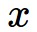
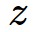
activations
f

Slide 64
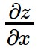
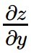
activations
f
“local gradient”

Slide 65
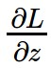
activations
f
“local gradient”
gradients

Slide 66
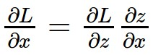
activations
f
“local gradient”
gradients

Slide 67
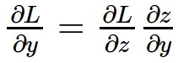
activations
f
“local gradient”
gradients

Slide 68
activations
f
“local gradient”
gradients

Slide 69
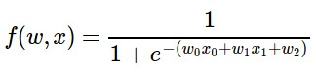
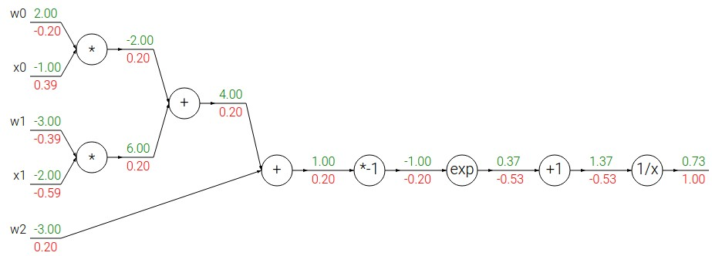
Another example:

Slide 70
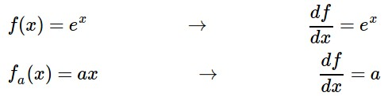
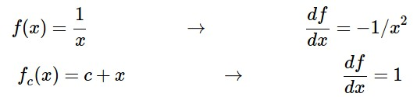
Another example:

Slide 71
Another example:

Slide 72
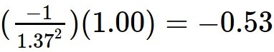
Another example:

Slide 73
Another example:

Slide 74

Another example:

Slide 75
Another example:

Slide 76

Another example:

Slide 77
Another example:

Slide 78
Another example:
(-1) * (-0.20) = 0.20

Slide 79
Another example:

Slide 80
Another example:
[local gradient] x [its gradient]
[1] x [0.2] = 0.2
[1] x [0.2] = 0.2 (both inputs!)

Slide 81
Another example:

Slide 82
Another example:
[local gradient] x [its gradient]
x0: [2] x [0.2] = 0.4
w0: [-1] x [0.2] = -0.2

Slide 83

sigmoid function
sigmoid gate

Slide 84
sigmoid function
sigmoid gate
(0.73) * (1 - 0.73) = 0.2

Slide 85

Patterns in backward flow
add gate: gradient distributor
max gate: gradient router
mul gate: gradient… “switcher”?

Slide 86
Gradients add at branches
+

Slide 87
Backprop Summary
Modern neural nets are very large
No hope of writing down gradient formula by hand for all parameters
Backpropagation: recursive application of the chain rule along a computational graph to compute the gradients of all inputs/parameters/intermediates
Should maintain a graph structure, where the nodes implement forward() and backward()
forward: compute result of an operation and save any intermediates needed for gradient computation in memory
backward: apply the chain rule to compute the gradient of the loss function with respect to the inputs

Slide 88

Full implementation of training a 2-layer Neural Network needs ~11 lines:
from @iamtrask, http://iamtrask.github.io/2015/07/12/basic-python-network/

Slide 89
How does this work in practice?
Initialize all weights to small, non-zero values
Choose a training point (or mini-batch) and clamp to input layer
Propagate signal forward thru network until output is generated
Calculate deltas for output layer

Slide 90
Backprop. in practice (cont’d)
Calculate deltas for previous layers by propagating errors backwards until a delta is calculated for every unit
Calculate weight updates for every weight
Update weights (using some update strategy)
Goto step 2

Slide 91
Notes on Backpropagation
Learning is incremental
Training examples will be presented multiple times
Especially with small learning rates
This is very basic backprop.
Other error functions
Momentum
Different learning rules
Backprop. will only find local minima
In practice, it works better with:
inputs in the range [-1, +1]
small weights

Slide 92
Why Multilayer?
What are the hidden layers doing?
One-Layer Perceptron
Two-Layer Perceptron

Slide 93
Feature / Representation Learning
Each layer maps input to a new feature space
You can get away with less clever feature representations using MLP
At what cost?
Increased VC dimension (also MLP prone to overfitting)
Nonlinearities can make interpretation of the hidden layers very difficult
Often, MLPs are treated as black boxes

Slide 94
Other Neural Networks
Backprop generalizes to networks that skip layers
Many variants of ANN
Multiple Outputs
Skip Layer Network
Recurrent Neural Networks

Slide 95
Multiple Outputs
Used for N-way classification
Each output node corresponds to a different class
Training labels are <0, 0, 1, 0, 0, 0>
Testing output: highest value wins!

Slide 96
Skip Layer Network
Input nodes are also sent directly to the output layer.

Slide 97
Recurrent Neural Networks
Output or hidden layer information is stored in a context or memory layer.
Output Layer
Hidden Layer
Context Layer
Input Layer

Slide 98
Recurrent Neural Networks
Output or hidden layer information is stored in a context or memory layer.
Output Layer
Hidden Layer
Context Layer
Input Layer

Slide 99
Time Delayed Recurrent Neural Networks (TDRNN)
Output layer from time t are used as inputs to the hidden layer at time t+1.
Output Layer
With an optional decay
Hidden Layer
Input Layer

Slide 100

MLPs in Action
Autonomous Driving Car
CMU Navlab
1990’s!!!
Neural Net Steering

Slide 101
Artificial Neural Networks
MLPs are a network of simple units
Lead to complex learners
Error backpropagation trains an MLP
Gradient descent applied to entire network
Trains network “one layer at a time”
These types of MLPs are usually ≤ 3 layers
Vanishing gradients
Too many params
Next Time: Deep Learning

